Slide 1
Predictive Modeling of Performance Grades Based on Demographics and Physical Measurements
MA 5790 - Group #5
Vinay Palakurthy
Vikramaditya Gurrapu

Slide 2
DATA EXPLORATION AND PREPROCESSING

Slide 3
Goal:
To build a predictive model to estimate or classify performance grades (A, B, C, D) based on the given features.
Data Source: https://www.kaggle.com/datasets/kukuroo3/body-performance-data
Data Structure:
13,393 Records
12 Features
1 Response Variable (Performance Grades)
10 Continuous Predictors, 1 Categorical Predictor

Slide 4
Continuous Predictors
age | systolic: systolic blood pressure (min)
height_cm | gripForce
weight_kg | sit and bend forward_cm
body fat_% | sit-ups counts
diastolic: diastolic blood pressure (min) | broad jump_cm
Categorical predictors
Gender

Slide 5
BEFORE TRANSFORMATIONS

Slide 6
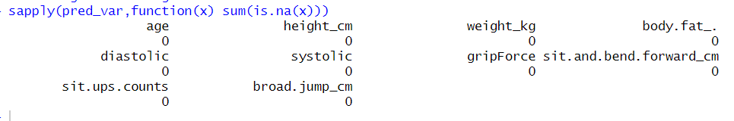
Checking For Missing Values:
Dataset had no missing values.
Adding Predictors:
BMI has been added based on Height and Weight.
Created dummy variables for Gender.

Slide 7
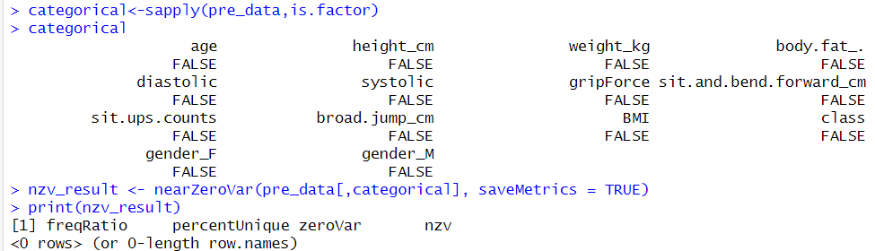
Checking For Near Zero Variance:
Dataset has no predictors for near zero variance.

Slide 8
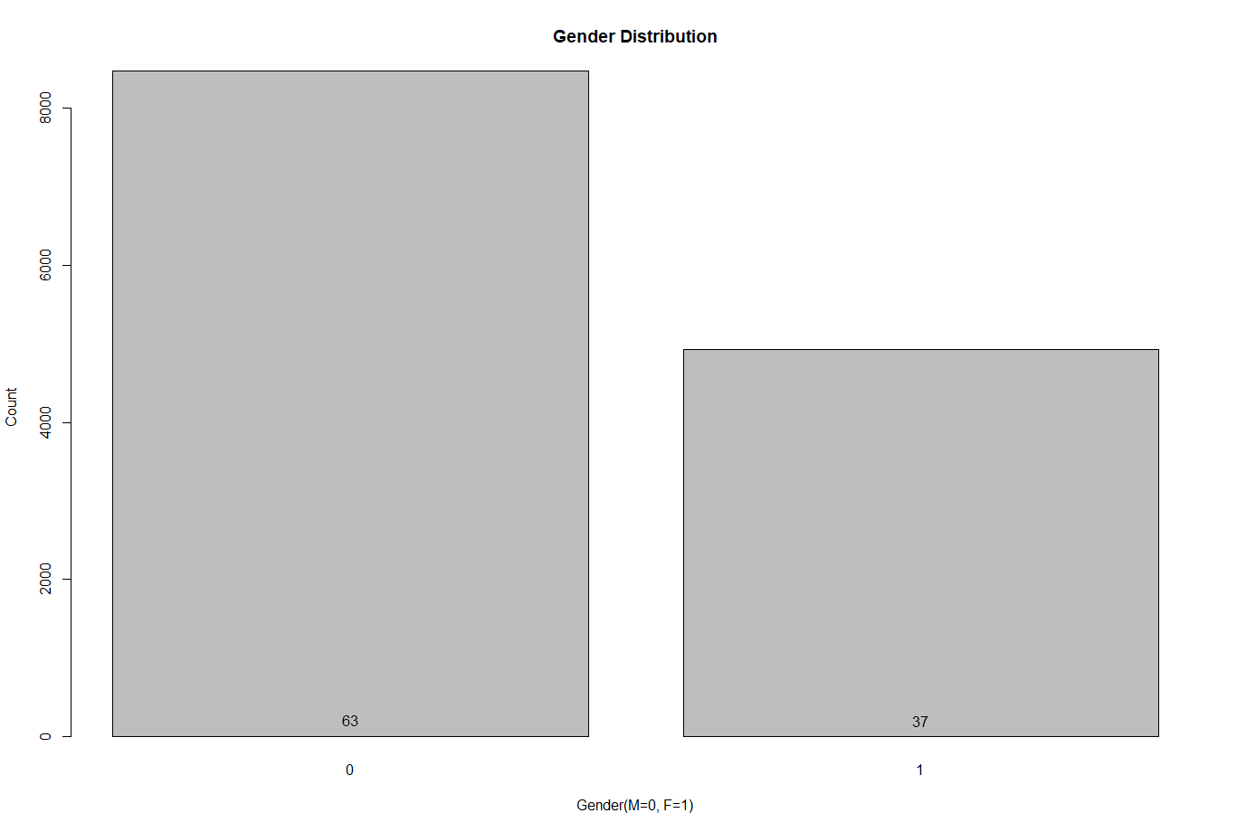
Bar Plot for Categorical Predictors

Slide 9
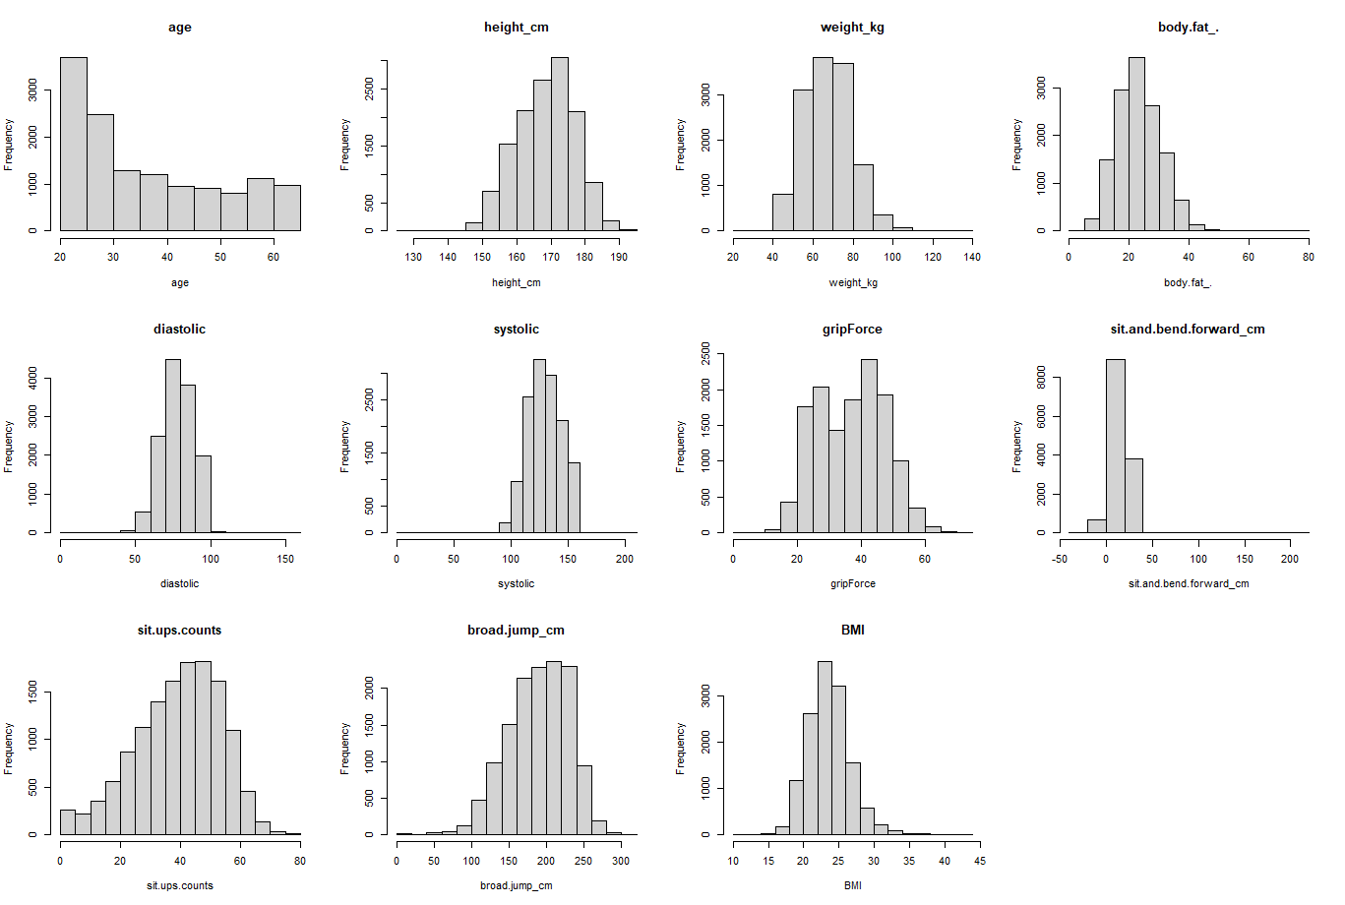
Data Distribution of Continuous Predictors Before Transformations

Slide 10
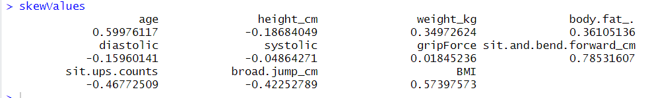
Skewness Values Before Transformation
“Age”, “sit and bend forward”, and “BMI” are moderately skewed.
All other predictors have approximately symmetric distributions.

Slide 11
Predictor | Skewness | Interpretation
age | 0.59976117 | Moderately Right Skewed
height_cm | -0.18684049 | Approximately Symmetric
weight_kg | 0.34972624 | Approximately Symmetric
bady.fat_. | 0.36105136 | Approximately Symmetric
diastolic | -0.15960141 | Approximately Symmetric
systolic | -0.04864271 | Approximately Symmetric
gripForce | 0.01845236 | Approximately Symmetric
sit.and.bend.forward_cm | 0.78531607 | Moderately Right Skewed
sit.ups.counts | -0.46772509 | Approximately Symmetric
board.jump_cm | -0.42252789 | Approximately Symmetric
BMI | 0.57397573 | Moderately Right Skewed

Slide 12
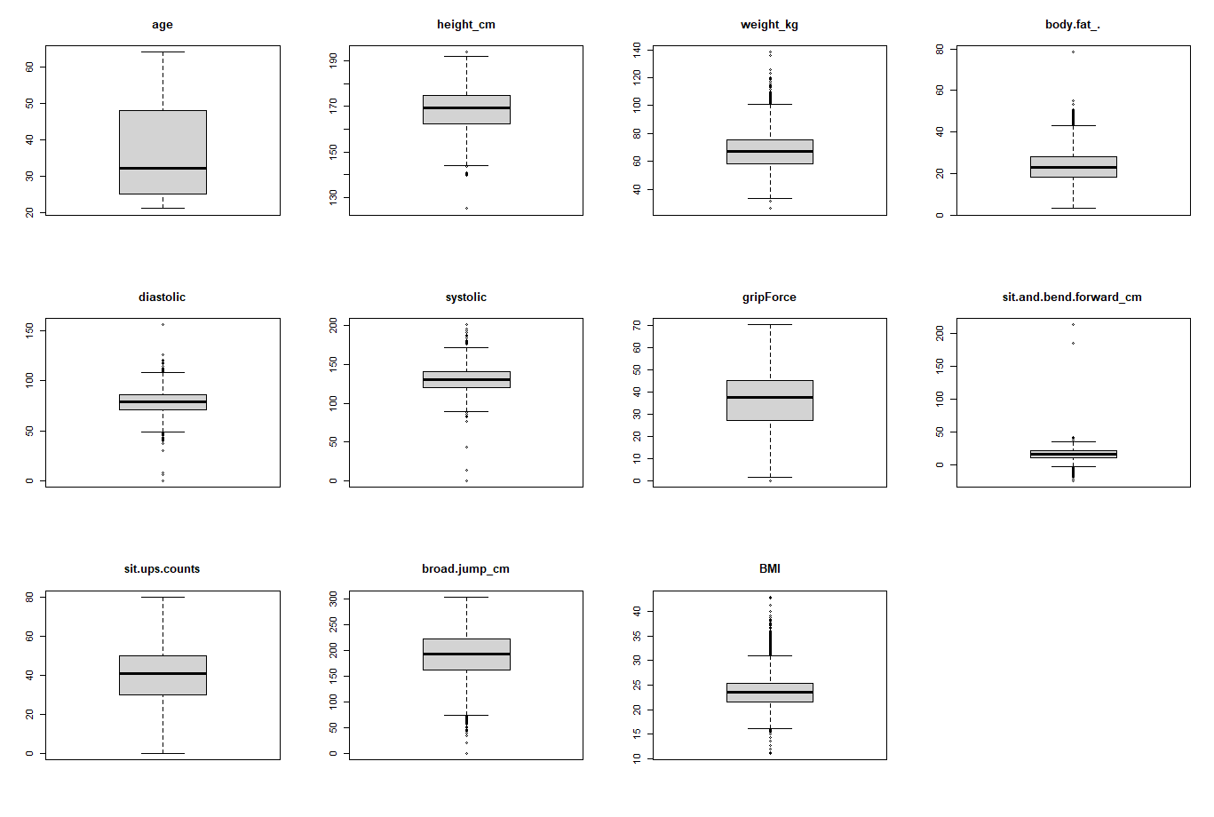
Data Outliers Before Transformation

Slide 13
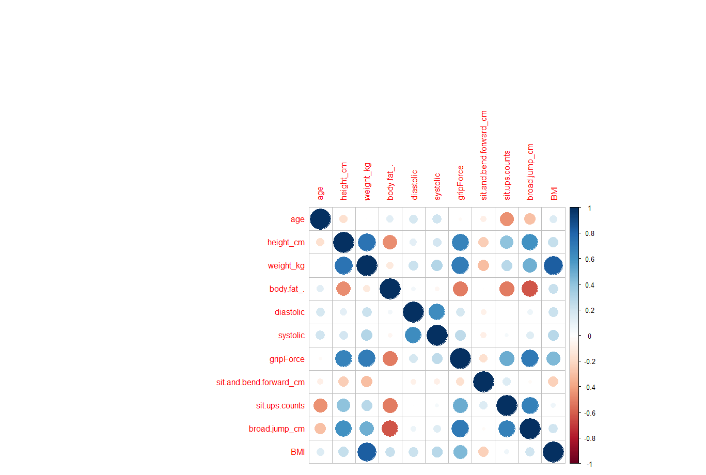
Correlation Plot Before Transformation

Slide 14
AFTER TRANSFORMATIONS

Slide 15
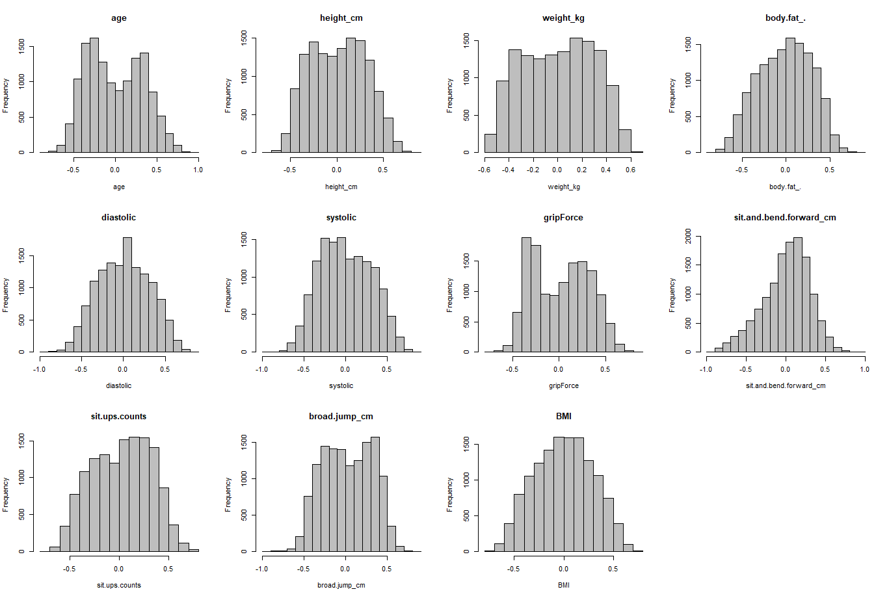
Data Distribution of Continuous Predictors After Transformations

Slide 16
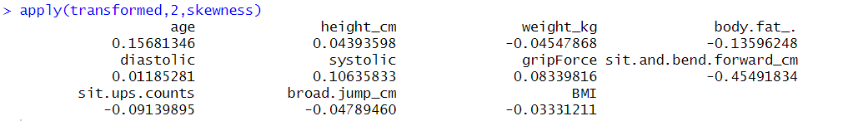
Skewness Values After Transformation
Skewness has been reduced after using Box cox Transformation.

Slide 17
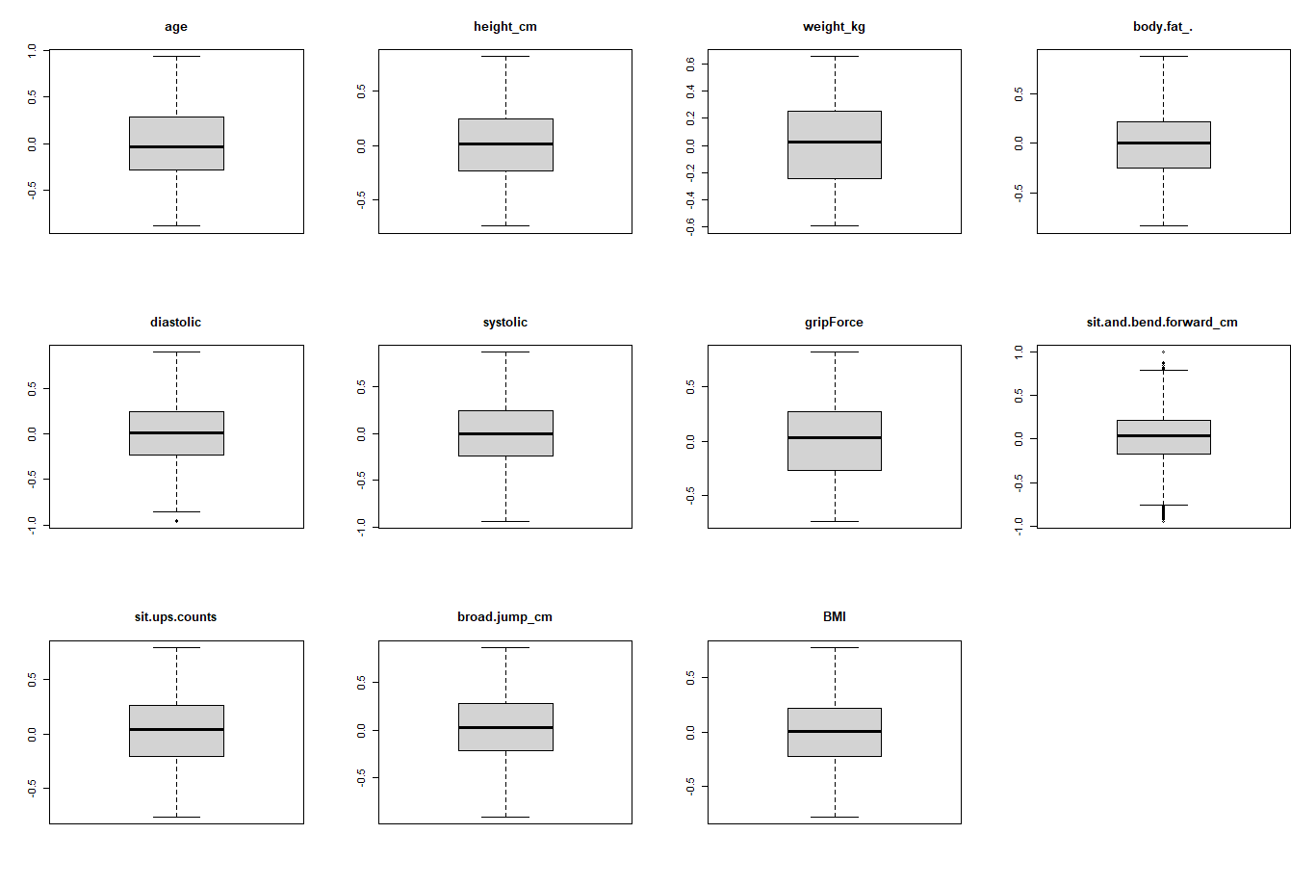
Data Outliers After Transformation
Spatial sign transformation minimized the effect of outliers

Slide 18
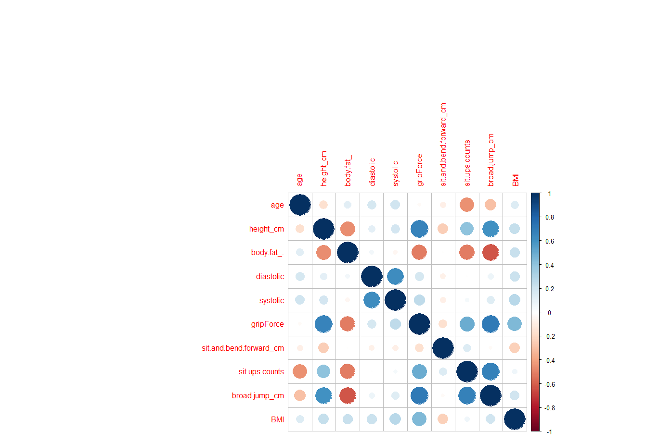
Correlation Plot After Transformation
Highly correlated variables were removed. (Cut Off: 0.75)

Slide 19
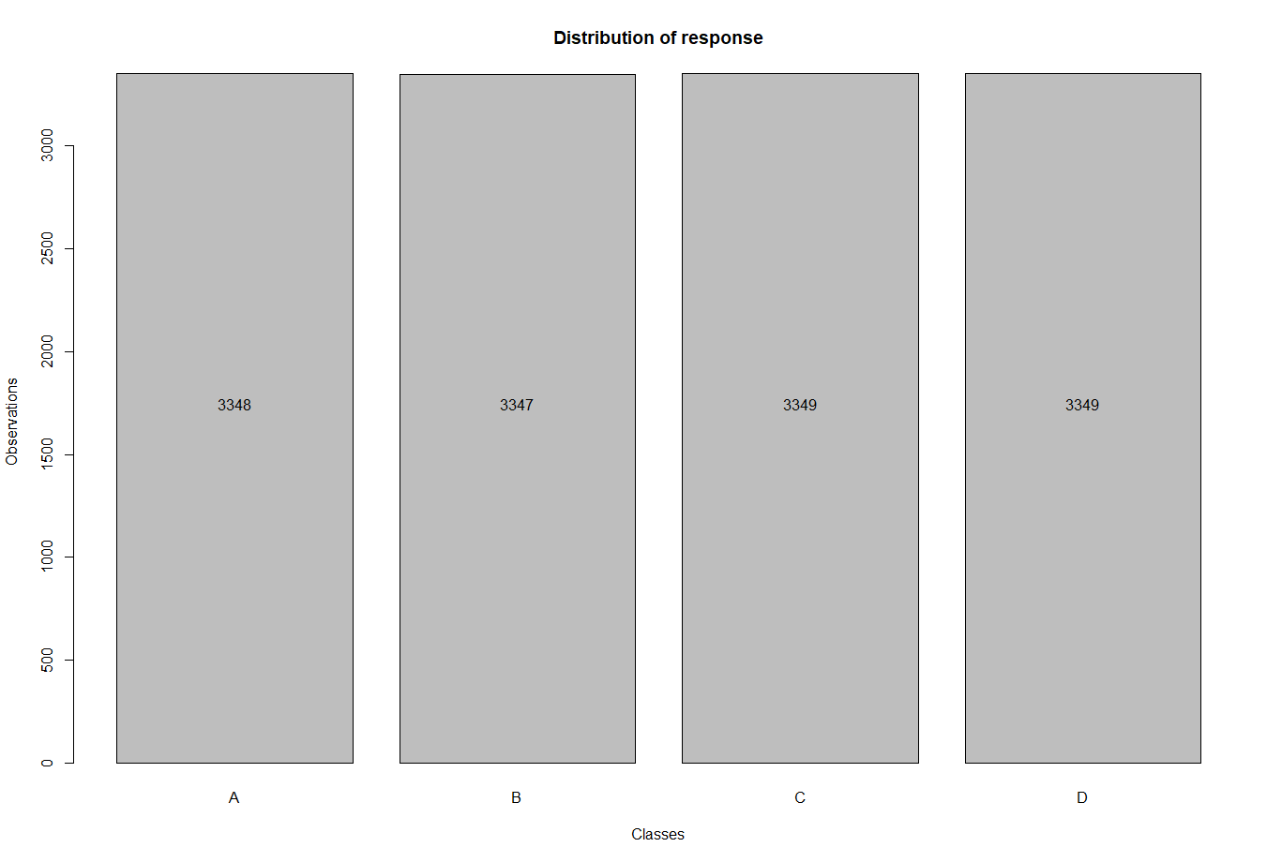
Response Variable Distribution

Slide 20
Spending And Resampling
Stratified Random Sampling
80% Training
20% Test
Stratified K fold Cross Validation
K : 5
After Preprocessing, we have
13,393 Records
12 Features - 1 Response Variable & 11 Predictors (Weight_kg has been removed and BMI is added)

Slide 21
MODEL BUILDING

Slide 22
Classification models
Linear Classification Models
Logistic Regression
Linear Discriminant Analysis (LDA)
Partial Least square discriminant analysis (PLSDA)
Penalized models
Nearest Shrunken centroids
NonLinear Classification Models
Nonlinear discriminant analysis
Neural Networks
Flexible discriminant analysis
Support Vector machines
K-Nearest Neighbors
Naive Bayes

Slide 23
LINEAR CLASSIFICATION MODELS
Overview of characteristics
Tuning Results and Plot
Confusion Matrix

Slide 24
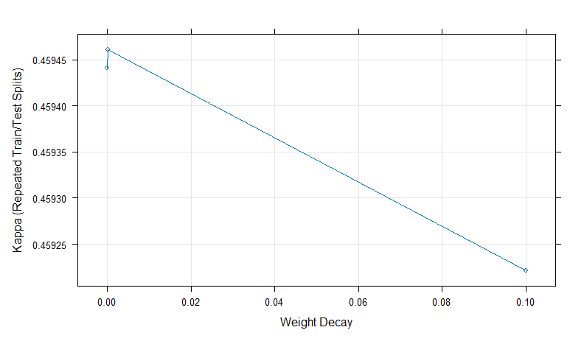
Logistic Regression
lrFull
Penalized Multinomial Regression
10717 samples
11 predictor
4 classes: 'A', 'B', 'C', 'D'
No pre-processing
Resampling: Repeated Train/Test Splits Estimated (25 reps, 75%)
Summary of sample sizes: 8039, 8039, 8039, 8039, 8039, 8039, ...
Resampling results across tuning parameters:
decay Accuracy Kappa
0e+00 0.5945780 0.4594408
1e-04 0.5945930 0.4594607
1e-01 0.5944137 0.4592214
Kappa was used to select the optimal model using the largest value.
The final value used for the model was decay = 1e-04.

Slide 25
Confusion Matrix and Statistics
confusionMatrix(lrPred,testY)
Reference
Prediction A B C D
A 482 187 72 5
B 159 268 139 37
C 27 172 289 109
D 1 42 169 518
Overall Statistics
Accuracy : 0.5818
95% CI : (0.5629, 0.6006)
No Information Rate : 0.25
P-Value [Acc > NIR] : < 2.2e-16
Kappa : 0.4425
Mcnemar's Test P-Value : 1.714e-07
Statistics by Class:
Class: A Class: B Class: C Class: D
Sensitivity 0.7205 0.4006 0.4320 0.7743
Specificity 0.8685 0.8331 0.8465 0.8944
Pos Pred Value 0.6461 0.4444 0.4841 0.7096
Neg Pred Value 0.9031 0.8066 0.8172 0.9224
Prevalence 0.2500 0.2500 0.2500 0.2500
Detection Rate 0.1801 0.1001 0.1080 0.1936
Detection Prevalence 0.2788 0.2253 0.2231 0.2728
Balanced Accuracy 0.7945 0.6168 0.6393 0.8343

Slide 26
Linear Discriminant Analysis (LDA)
LDAFull
Linear Discriminant Analysis
10717 samples
11 predictor
4 classes: 'A', 'B', 'C', 'D'
No pre-processing
Resampling: Cross-Validated (5 fold)
Summary of sample sizes: 8574, 8574, 8573, 8573, 8574
Resampling results:
Accuracy Kappa
0.5936361 0.4581794
NO PLOT
(There are no tuning parameters for this model.)

Slide 27
Confusion Matrix and Statistics
confusionMatrix(LDAPred,testY)
Reference
Prediction A B C D
A 479 192 72 5
B 165 269 140 38
C 25 171 301 117
D 0 37 156 509
Overall Statistics
Accuracy : 0.5822
95% CI : (0.5633, 0.601)
No Information Rate : 0.25
P-Value [Acc > NIR] : < 2.2e-16
Kappa : 0.4429
Mcnemar's Test P-Value : 9.009e-07
Statistics by Class:
Class: A Class: B Class: C Class: D
Sensitivity 0.7160 0.4021 0.4499 0.7608
Specificity 0.8660 0.8291 0.8440 0.9038
Pos Pred Value 0.6404 0.4395 0.4902 0.7251
Neg Pred Value 0.9015 0.8062 0.8215 0.9189
Prevalence 0.2500 0.2500 0.2500 0.2500
Detection Rate 0.1790 0.1005 0.1125 0.1902
Detection Prevalence 0.2795 0.2287 0.2294 0.2623
Balanced Accuracy 0.7910 0.6156 0.6470 0.8323

Slide 28
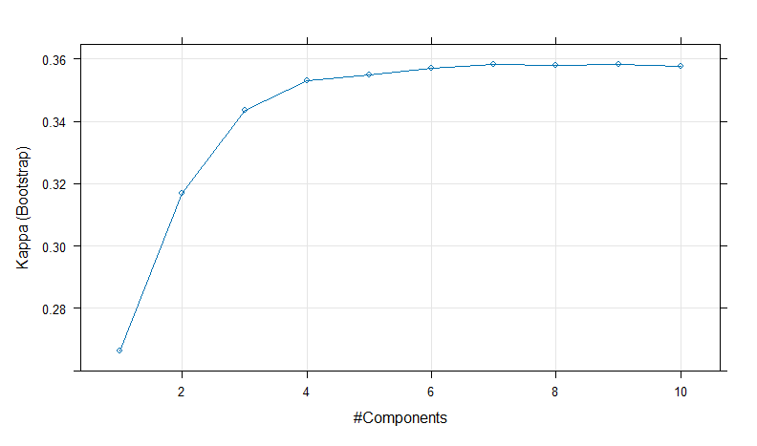
Partial Least square discriminant analysis (PLSDA)
plsFit
Partial Least Squares
10717 samples
11 predictor
4 classes: 'A', 'B', 'C', 'D'
Pre-processing: centered (11), scaled (11)
Resampling: Bootstrapped (25 reps)
Summary of sample sizes: 10717, 10717, 10717, 10717, 10717, 10717, ...
Resampling results across tuning parameters:
ncomp Accuracy Kappa
1 0.4501972 0.2663917
.
.
6 0.5178862 0.3569375
7 0.5188414 0.3582046
8 0.5186626 0.3579707
9 0.5187861 0.3581344
Kappa was used to select the optimal model using the largest value.
The final value used for the model was ncomp = 7.

Slide 29
Confusion Matrix and Statistics
confusionMatrix(plsPred,testY)
Reference
Prediction A B C D
A 622 417 186 32
B 15 27 24 3
C 14 73 120 30
D 18 152 339 604
Overall Statistics
Accuracy : 0.5131
95% CI : (0.4939, 0.5322)
No Information Rate : 0.25
P-Value [Acc > NIR] : < 2.2e-16
Kappa : 0.3508
Mcnemar's Test P-Value : < 2.2e-16
Statistics by Class:
Class: A Class: B Class: C Class: D
Sensitivity 0.9297 0.04036 0.17937 0.9028
Specificity 0.6836 0.97907 0.94170 0.7464
Pos Pred Value 0.4948 0.39130 0.50633 0.5427
Neg Pred Value 0.9669 0.75374 0.77491 0.9584
Prevalence 0.2500 0.25000 0.25000 0.2500
Detection Rate 0.2324 0.01009 0.04484 0.2257
Detection Prevalence 0.4697 0.02578 0.08857 0.4159
Balanced Accuracy 0.8067 0.50972 0.56054 0.8246

Slide 30
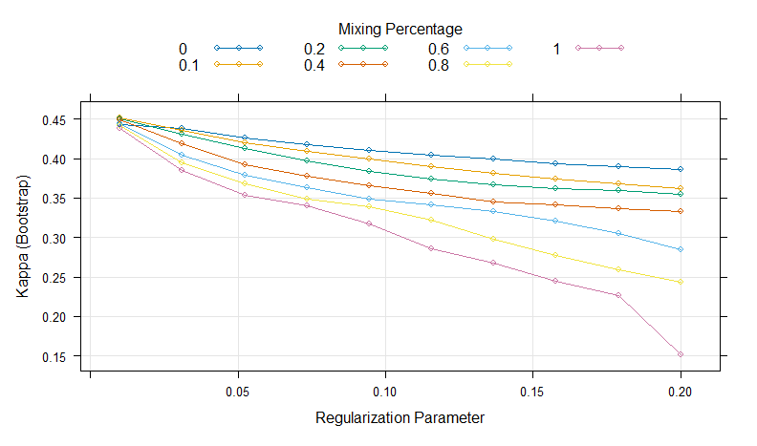
Penalized models
glmnTuned
glmnet
10717 samples
11 predictor
4 classes: 'A', 'B', 'C', 'D'
Pre-processing: centered (11), scaled (11)
Resampling: Bootstrapped (25 reps)
Summary of sample sizes: 10717, 10717, 10717, 10717, 10717, 10717, ...
Resampling results across tuning parameters:
alpha lambda Accuracy Kappa
0.0 0.01000000 0.5826617 0.4436462
.
0.0 0.17888889 0.5421136 0.3897408
0.0 0.20000000 0.5392904 0.3859904
0.1 0.01000000 0.5884637 0.4513643
0.1 0.03111111 0.5766381 0.4356473
0.1 0.05222222 0.5653146 0.4205832
Kappa was used to select the optimal model using the largest value.
The final values used for the model were alpha = 0.1 and lambda = 0.01.

Slide 31
Confusion Matrix and Statistics
confusionMatrix(glmnPred,testY)
Confusion Matrix and Statistics
Reference
Prediction A B C D
A 499 203 82 8
B 143 249 125 38
C 24 161 274 98
D 3 56 188 525
Overall Statistics
Accuracy : 0.5781
95% CI : (0.5591, 0.5969)
No Information Rate : 0.25
P-Value [Acc > NIR] : < 2.2e-16
Kappa : 0.4375
Mcnemar's Test P-Value : 2.545e-15
Statistics by Class:
Class: A Class: B Class: C Class: D
Sensitivity 0.7459 0.37220 0.4096 0.7848
Specificity 0.8540 0.84753 0.8590 0.8769
Pos Pred Value 0.6301 0.44865 0.4919 0.6801
Neg Pred Value 0.9098 0.80198 0.8136 0.9244
Prevalence 0.2500 0.25000 0.2500 0.2500
Detection Rate 0.1865 0.09305 0.1024 0.1962
Detection Prevalence 0.2960 0.20740 0.2081 0.2885
Balanced Accuracy 0.8000 0.60987 0.6343 0.8308

Slide 32
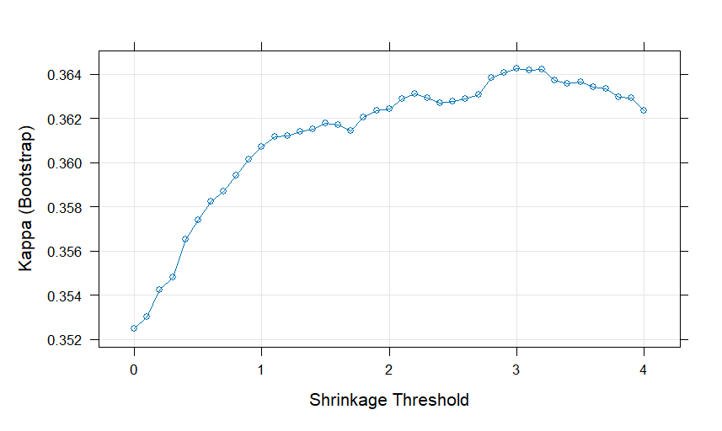
Nearest Shrunken Centroids
nsc_model
Nearest Shrunken Centroids
10717 samples
11 predictor
4 classes: 'A', 'B', 'C', 'D'
No pre-processing
Resampling: Bootstrapped (25 reps)
Summary of sample sizes: 10717, 10717, 10717, 10717, 10717, 10717, ...
Resampling results across tuning parameters:
threshold Accuracy Kappa
0.0 0.5141704 0.3524828
.
.
2.8 0.5225439 0.3638525
2.9 0.5227079 0.3640801
3.0 0.5228237 0.3642376
3.1 0.5227749 0.3641800
3.2 0.5227835 0.3641987
Kappa was used to select the optimal model using the largest value.
The final value used for the model was threshold = 3.

Slide 33
Confusion Matrix and Statistics
confusionMatrix(data = pred_nsc_model,reference = testY)
Reference
Prediction A B C D
A 523 285 141 23
B 110 138 95 42
C 19 132 203 78
D 17 114 230 526
Overall Statistics
Accuracy : 0.5194
95% CI : (0.5003, 0.5385)
No Information Rate : 0.25
P-Value [Acc > NIR] : < 2.2e-16
Kappa : 0.3592
Mcnemar's Test P-Value : < 2.2e-16
Statistics by Class:
Class: A Class: B Class: C Class: D
Sensitivity 0.7818 0.20628 0.30344 0.7862
Specificity 0.7763 0.87693 0.88590 0.8201
Pos Pred Value 0.5381 0.35844 0.46991 0.5930
Neg Pred Value 0.9143 0.76822 0.79234 0.9201
Prevalence 0.2500 0.25000 0.25000 0.2500
Detection Rate 0.1954 0.05157 0.07586 0.1966
Detection Prevalence 0.3632 0.14387 0.16143 0.3315
Balanced Accuracy 0.7790 0.54160 0.59467 0.8032

Slide 34
NON LINEAR CLASSIFICATION MODELS
Overview of characteristics
Tuning Results and Plot
Confusion Matrix

Slide 35
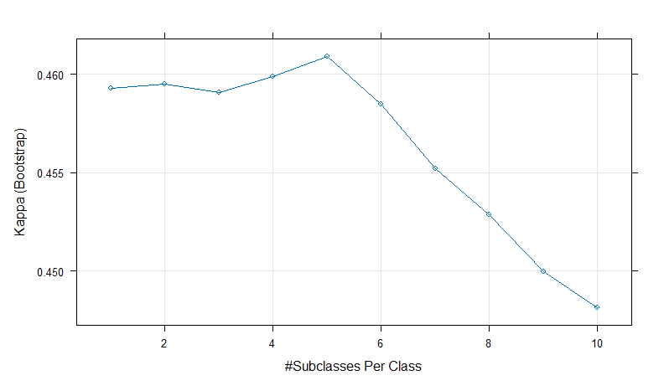
Non Linear Discriminant Analysis
(Mixture Discriminant Analysis)
mdaFit
Mixture Discriminant Analysis
10717 samples
11 predictor
4 classes: 'A', 'B', 'C', 'D'
No pre-processing
Resampling: Bootstrapped (25 reps)
Summary of sample sizes: 10717, 10717, 10717, 10717, 10717, 10717, ...
Resampling results across tuning parameters:
subclasses Accuracy Kappa
1 0.5944420 0.4592794
.
4 0.5949429 0.4599039
5 0.5956870 0.4609041
6 0.5938899 0.4584962
Kappa was used to select the optimal model using the largest value.
The final value used for the model was subclasses = 5.

Slide 36
Confusion Matrix and Statistics
confusionMatrix(mdaPred,testY)
Reference
Prediction A B C D
A 486 211 79 4
B 149 255 129 34
C 32 164 336 106
D 2 39 125 525
Overall Statistics
Accuracy : 0.5987
95% CI : (0.5798, 0.6173)
No Information Rate : 0.25
P-Value [Acc > NIR] : < 2.2e-16
Kappa : 0.4649
Mcnemar's Test P-Value : 1.517e-06
Statistics by Class:
Class: A Class: B Class: C Class: D
Sensitivity 0.7265 0.38117 0.5022 0.7848
Specificity 0.8535 0.84454 0.8495 0.9173
Pos Pred Value 0.6231 0.44974 0.5266 0.7598
Neg Pred Value 0.9035 0.80370 0.8366 0.9275
Prevalence 0.2500 0.25000 0.2500 0.2500
Detection Rate 0.1816 0.09529 0.1256 0.1962
Detection Prevalence 0.2915 0.21188 0.2384 0.2582
Balanced Accuracy 0.7900 0.61286 0.6759 0.8510

Slide 37
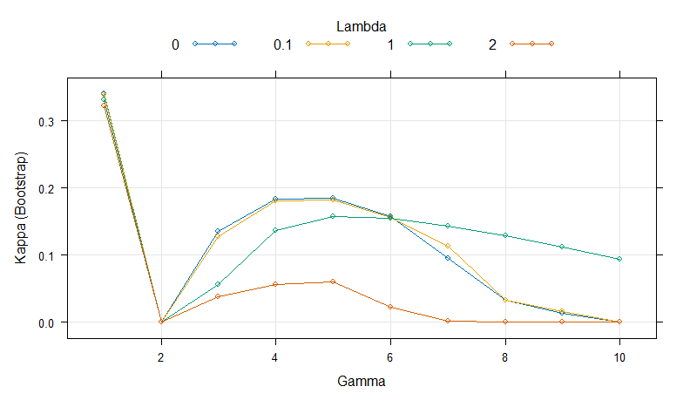
Non Linear Discriminant Analysis
(Regularized Discriminant Analysis)
rdaFit
Regularized Discriminant Analysis
10717 samples
11 predictor
4 classes: 'A', 'B', 'C', 'D'
No pre-processing
Resampling: Bootstrapped (25 reps)
Summary of sample sizes: 10717, 10717, 10717, 10717, 10717, 10717, ...
Resampling results across tuning parameters:
gamma lambda Accuracy Kappa
1 0.0 0.5046417 0.339721545
1 0.1 0.5038834 0.338710020
1 1.0 0.4983261 0.331331569
.
.
10 2.0 0.2487572 0.000000000
Kappa was used to select the optimal model using the largest value.
The final values used for the model were gamma = 1 and lambda = 0.

Slide 38
Confusion Matrix and Statistics
confusionMatrix(pred_rda_model,testY)
Reference
Prediction A B C D
A 428 233 119 19
B 190 233 133 36
C 23 78 223 134
D 28 125 194 480
Overall Statistics
Accuracy : 0.5097
95% CI : (0.4906, 0.5288)
No Information Rate : 0.25
P-Value [Acc > NIR] : < 2.2e-16
Kappa : 0.3463
Mcnemar's Test P-Value : < 2.2e-16
Statistics by Class:
Class: A Class: B Class: C Class: D
Sensitivity 0.6398 0.34828 0.33333 0.7175
Specificity 0.8151 0.82113 0.88291 0.8271
Pos Pred Value 0.5357 0.39358 0.48690 0.5804
Neg Pred Value 0.8716 0.79079 0.79892 0.8978
Prevalence 0.2500 0.25000 0.25000 0.2500
Detection Rate 0.1599 0.08707 0.08333 0.1794
Detection Prevalence 0.2986 0.22123 0.17115 0.3090
Balanced Accuracy 0.7275 0.58470 0.60812 0.7723

Slide 39
Non Linear Discriminant Analysis
(Quadratic Discriminant Analysis)
qdaFit
Quadratic Discriminant Analysis
10717 samples
11 predictor
4 classes: 'A', 'B', 'C', 'D'
Pre-processing: centered (11), scaled (11)
Resampling: Cross-Validated (5 fold)
Summary of sample sizes: 8575, 8573, 8574, 8573, 8573
Resampling results:
Accuracy Kappa
0.633948 0.5119333
NO PLOT
(There are no tuning parameters for this model.)

Slide 40
Confusion Matrix and Statistics
confusionMatrix(qdaPred,testY)
Confusion Matrix and Statistics
Reference
Prediction A B C D
A 504 178 59 5
B 150 332 153 40
C 11 126 347 105
D 4 33 110 519
Overall Statistics
Accuracy : 0.636
95% CI : (0.6175, 0.6543)
No Information Rate : 0.25
P-Value [Acc > NIR] : < 2.2e-16
Kappa : 0.5147
Mcnemar's Test P-Value : 7.777e-07
Statistics by Class:
Class: A Class: B Class: C Class: D
Sensitivity 0.7534 0.4963 0.5187 0.7758
Specificity 0.8794 0.8291 0.8794 0.9268
Pos Pred Value 0.6756 0.4919 0.5891 0.7793
Neg Pred Value 0.9145 0.8316 0.8457 0.9254
Prevalence 0.2500 0.2500 0.2500 0.2500
Detection Rate 0.1883 0.1241 0.1297 0.1939
Detection Prevalence 0.2788 0.2522 0.2201 0.2489
Balanced Accuracy 0.8164 0.6627 0.6991 0.8513

Slide 41
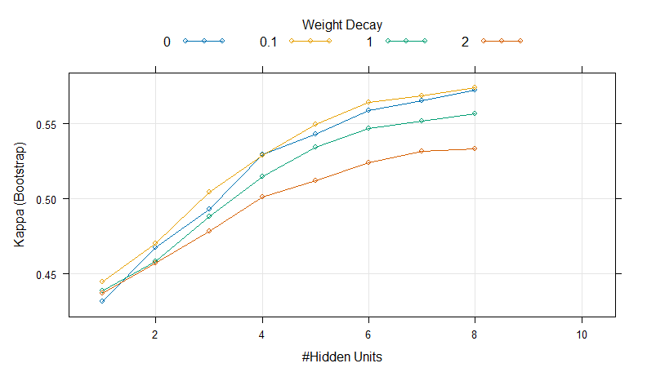
Neural Networks
nnetFit
Neural Network
10717 samples
11 predictor
4 classes: 'A', 'B', 'C', 'D'
Pre-processing: centered (11), scaled (11), spatial sign transformation (11)
Resampling: Bootstrapped (25 reps)
Summary of sample sizes: 10717, 10717, 10717, 10717, 10717, 10717, ...
Resampling results across tuning parameters:
size decay Accuracy Kappa
1 0.0 0.5736985 0.4315120
.
.
7 2.0 0.6487375 0.5317173
8 0.0 0.6794265 0.5725643
8 0.1 0.6804294 0.5738997
8 1.0 0.6674332 0.5566110
8 2.0 0.6499464 0.5333166
Kappa was used to select the optimal model using the largest value.
The final values used for the model were size = 8 and decay = 0.1.

Slide 42
Confusion Matrix and Statistics
confusionMatrix(nnetPred,testY)
Reference
Prediction A B C D
A 551 167 62 3
B 114 367 118 38
C 4 118 422 118
D 0 17 67 510
Overall Statistics
Accuracy : 0.6913
95% CI : (0.6734, 0.7088)
No Information Rate : 0.25
P-Value [Acc > NIR] : < 2.2e-16
Kappa : 0.5884
Mcnemar's Test P-Value : < 2.2e-16
Statistics by Class:
Class: A Class: B Class: C Class: D
Sensitivity 0.8236 0.5486 0.6308 0.7623
Specificity 0.8844 0.8655 0.8804 0.9581
Pos Pred Value 0.7037 0.5761 0.6375 0.8586
Neg Pred Value 0.9377 0.8519 0.8774 0.9236
Prevalence 0.2500 0.2500 0.2500 0.2500
Detection Rate 0.2059 0.1371 0.1577 0.1906
Detection Prevalence 0.2926 0.2380 0.2474 0.2220
Balanced Accuracy 0.8540 0.7070 0.7556 0.8602

Slide 43
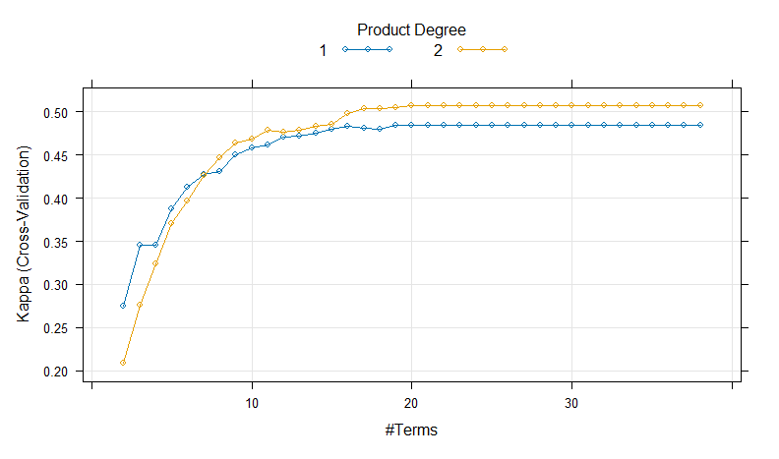
Flexible Discriminant Analysis
fdaTuned
Flexible Discriminant Analysis
10717 samples
11 predictor
4 classes: 'A', 'B', 'C', 'D'
No pre-processing
Resampling: Cross-Validated (10 fold)
Summary of sample sizes: 9645, 9645, 9645, 9645, 9645, 9645, ...
Resampling results across tuning parameters:
degree nprune Accuracy Kappa
1 2 0.4560974 0.2747951
.
.
2 17 0.6277842 0.5037151
2 18 0.6277836 0.5037148
2 19 0.6286224 0.5048325
2 20 0.6301160 0.5068240
2 21 0.6301160 0.5068240
2 22 0.6301160 0.5068240
Kappa was used to select the optimal model using the largest value.
The final values used for the model were degree = 2 and nprune = 20.

Slide 44
Confusion Matrix and Statistics
confusionMatrix(fdaPred,testY)
Reference
Prediction A B C D
A 480 154 72 7
B 182 334 138 39
C 7 157 384 141
D 0 24 75 482
Overall Statistics
Accuracy : 0.6278
95% CI : (0.6092, 0.6462)
No Information Rate : 0.25
P-Value [Acc > NIR] : < 2.2e-16
Kappa : 0.5037
Mcnemar's Test P-Value : < 2.2e-16
Statistics by Class:
Class: A Class: B Class: C Class: D
Sensitivity 0.7175 0.4993 0.5740 0.7205
Specificity 0.8839 0.8211 0.8480 0.9507
Pos Pred Value 0.6732 0.4820 0.5573 0.8296
Neg Pred Value 0.9037 0.8311 0.8566 0.9107
Prevalence 0.2500 0.2500 0.2500 0.2500
Detection Rate 0.1794 0.1248 0.1435 0.1801
Detection Prevalence 0.2664 0.2590 0.2575 0.2171
Balanced Accuracy 0.8007 0.6602 0.7110 0.8356

Slide 45
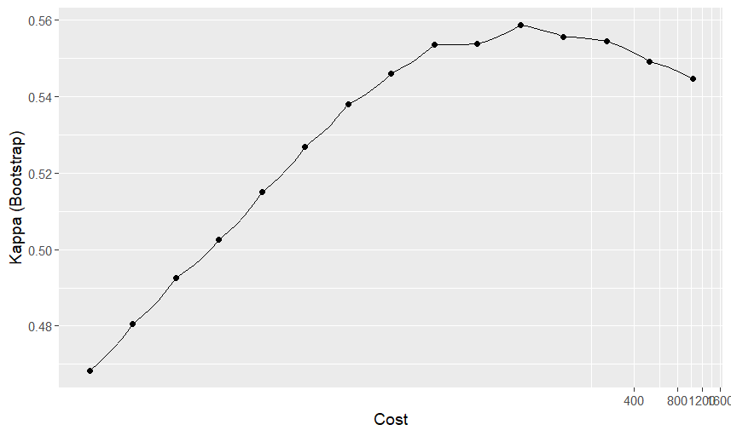
Support Vector Machines
svmRModel
Support Vector Machines with Radial Basis Function Kernel
10717 samples
11 predictor
4 classes: 'A', 'B', 'C', 'D'
Pre-processing: centered (11), scaled (11)
Resampling: Bootstrapped (25 reps)
Summary of sample sizes: 10717, 10717, 10717, 10717, 10717, 10717, ...
Resampling results across tuning parameters:
C Accuracy Kappa
0.0625 0.6013189 0.4683761
.
.
32.0000 0.6653507 0.5537828
64.0000 0.6690590 0.5586943
128.0000 0.6668177 0.5557055
256.0000 0.6659476 0.5545723
Tuning parameter 'sigma' was held constant at a value of 0.02795102
Kappa was used to select the optimal model using the largest value.
The final values used for the model were sigma = 0.02795102 and C = 64.

Slide 46
Confusion Matrix and Statistics
confusionMatrix(svmPred,testY)
Confusion Matrix and Statistics
Reference
Prediction A B C D
A 537 169 56 12
B 129 345 130 40
C 3 136 423 123
D 0 19 60 494
Overall Statistics
Accuracy : 0.6723
95% CI : (0.6541, 0.69)
No Information Rate : 0.25
P-Value [Acc > NIR] : < 2.2e-16
Kappa : 0.563
Mcnemar's Test P-Value : < 2.2e-16
Statistics by Class:
Class: A Class: B Class: C Class: D
Sensitivity 0.8027 0.5157 0.6323 0.7384
Specificity 0.8819 0.8510 0.8695 0.9606
Pos Pred Value 0.6938 0.5357 0.6175 0.8621
Neg Pred Value 0.9306 0.8406 0.8764 0.9168
Prevalence 0.2500 0.2500 0.2500 0.2500
Detection Rate 0.2007 0.1289 0.1581 0.1846
Detection Prevalence 0.2892 0.2407 0.2560 0.2141
Balanced Accuracy 0.8423 0.6834 0.7509 0.8495

Slide 47
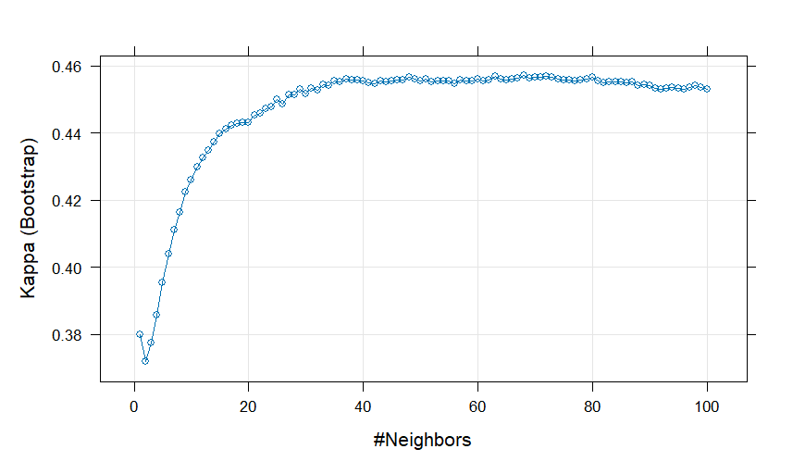
K-Nearest Neighbours
knnFit
k-Nearest Neighbors
10717 samples
11 predictor
4 classes: 'A', 'B', 'C', 'D'
Pre-processing: centered (11), scaled (11)
Resampling: Bootstrapped (25 reps)
Summary of sample sizes: 10717, 10717, 10717, 10717, 10717, 10717, ...
Resampling results across tuning parameters:
k Accuracy Kappa
1 0.5349923 0.3799595
.
.
66 0.5921279 0.4560861
67 0.5922816 0.4562921
68 0.5928277 0.4570161
69 0.5923807 0.4564185
70 0.5925259 0.4566126
71 0.5924039 0.4564456
Kappa was used to select the optimal model using the largest value.
The final value used for the model was k = 68.

Slide 48
Confusion Matrix and Statistics
confusionMatrix(knnPred,testY)
Reference
Prediction A B C D
A 549 272 103 13
B 113 236 157 42
C 6 118 307 111
D 1 43 102 503
Overall Statistics
Accuracy : 0.596
95% CI : (0.5772, 0.6147)
No Information Rate : 0.25
P-Value [Acc > NIR] : < 2.2e-16
Kappa : 0.4614
Mcnemar's Test P-Value : < 2.2e-16
Statistics by Class:
Class: A Class: B Class: C Class: D
Sensitivity 0.8206 0.35277 0.4589 0.7519
Specificity 0.8067 0.84454 0.8829 0.9273
Pos Pred Value 0.5859 0.43066 0.5664 0.7750
Neg Pred Value 0.9310 0.79652 0.8304 0.9181
Prevalence 0.2500 0.25000 0.2500 0.2500
Detection Rate 0.2052 0.08819 0.1147 0.1880
Detection Prevalence 0.3501 0.20478 0.2025 0.2425
Balanced Accuracy 0.8137 0.59865 0.6709 0.8396

Slide 49
Naive Bayes
nbFit
Naive Bayes
10717 samples
11 predictor
4 classes: 'A', 'B', 'C', 'D'
No pre-processing
Resampling: Bootstrapped (25 reps)
Summary of sample sizes: 10717, 10717, 10717, 10717, 10717, 10717, ...
Resampling results:
Accuracy Kappa
0.550101 0.4001948
Tuning parameter 'fL' was held constant at a value of 2
Tuning parameter 'usekernel'
was held constant at a value of TRUE
Tuning parameter 'adjust' was held constant at
a value of TRUE
NO PLOT
(There are no tuning parameters with more than 1 value)

Slide 50
Confusion Matrix and Statistics
confusionMatrix(nbPred,testY)
Reference
Prediction A B C D
A 497 221 110 18
B 129 243 127 39
C 21 104 247 100
D 22 101 185 512
Overall Statistics
Accuracy : 0.5602
95% CI : (0.5411, 0.5791)
No Information Rate : 0.25
P-Value [Acc > NIR] : < 2.2e-16
Kappa : 0.4136
Mcnemar's Test P-Value : < 2.2e-16
Statistics by Class:
Class: A Class: B Class: C Class: D
Sensitivity 0.7429 0.36323 0.3692 0.7653
Specificity 0.8261 0.85301 0.8879 0.8465
Pos Pred Value 0.5875 0.45167 0.5233 0.6244
Neg Pred Value 0.9060 0.80075 0.8085 0.9154
Prevalence 0.2500 0.25000 0.2500 0.2500
Detection Rate 0.1857 0.09081 0.0923 0.1913
Detection Prevalence 0.3161 0.20105 0.1764 0.3064
Balanced Accuracy 0.7845 0.60812 0.6286 0.8059

Slide 51
SUMMARY TABLE
Top 2 models (Metric = Kappa)
Important Predictors of Best Models

Slide 52
Summary Results
CLASSIFICATION MODEL | TRAINING KAPPA | TESTING KAPPA | BEST TUNING PARAMETER
Logistic Regression | 0.4594607 | 0.4425 | Decay = 1e-04
Linear Discriminant Analysis | 0.4581794 | 0.4429 | NA
Partial Least Square Discriminant Analysis | 0.3582046 | 0.3508 | ncomp = 7
Penalized Models | 0.4513643 | 0.4375 | alpha = 0.1, lambda = 0.01
Nearest Shrunken Centroids | 0.3642376 | 0.3592 | threshold = 3
Mixture Discriminant Analysis | 0.4609041 | 0.4649 | subclasses = 5

Slide 53
CLASSIFICATION MODEL | TRAINING KAPPA | TESTING KAPPA | BEST TUNING PARAMETER
Regularized Discriminant Analysis | 0.339721545 | 0.3463 | gamma = 1, lambda = 0.0
Quadratic Discriminant Analysis | 0.5119333 | 0.5147 | NA
Neural Networks | 0.5738997 | 0.5884 | size = 8, decay = 0.1
Flexible Discriminant Analysis | 0.5068240 | 0.5037 | degree = 2, nprune = 20
Support Vector Machines | 0.5586943 | 0.563 | sigma = 0.02795102, C = 64
K-Nearest Neighbours | 0.4570161 | 0.4614 | k = 68
Naive Bayes | 0.4001948 | 0.4136 | Tuning parameter ‘fL’ was held constant at a value of 2

Slide 54
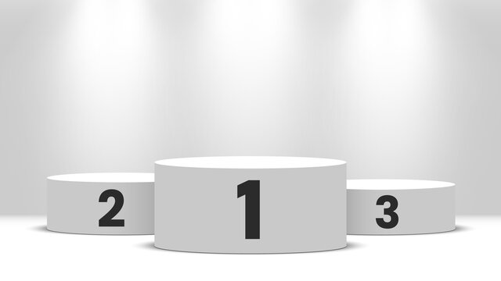
“BEST CLASSIFICATION MODEL”
Neural Networks
SVM
QDA

Slide 55
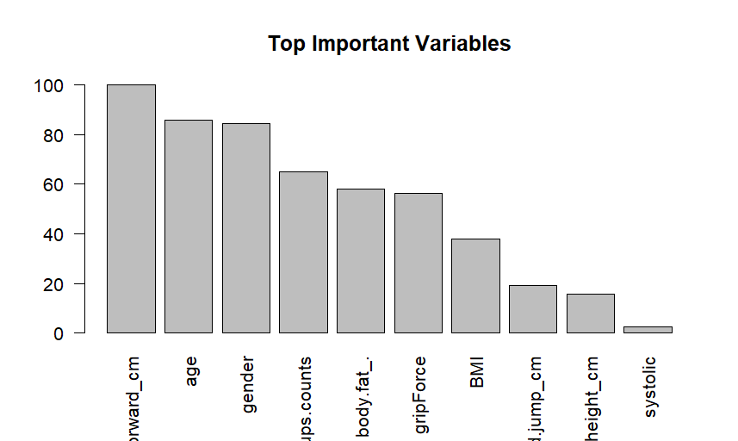
Important Predictors of Neural Networks
top_5
nnet variable importance
variables are sorted by maximum importance across the classes
Overall A B C D
sit.and.bend.forward_cm 100.000 100.000 100.000 100.000 100.000
age 85.599 85.599 85.599 85.599 85.599
gender 84.230 84.230 84.230 84.230 84.230
sit.ups.counts 65.053 65.053 65.053 65.053 65.053
body.fat_. 58.141 58.141 58.141 58.141 58.141
gripForce 56.380 56.380 56.380 56.380 56.380
BMI 37.982 37.982 37.982 37.982 37.982
broad.jump_cm 19.318 19.318 19.318 19.318 19.318
height_cm 15.558 15.558 15.558 15.558 15.558
systolic 2.337 2.337 2.337 2.337 2.337
diastolic 0.000 0.000 0.000 0.000 0.000

Slide 56
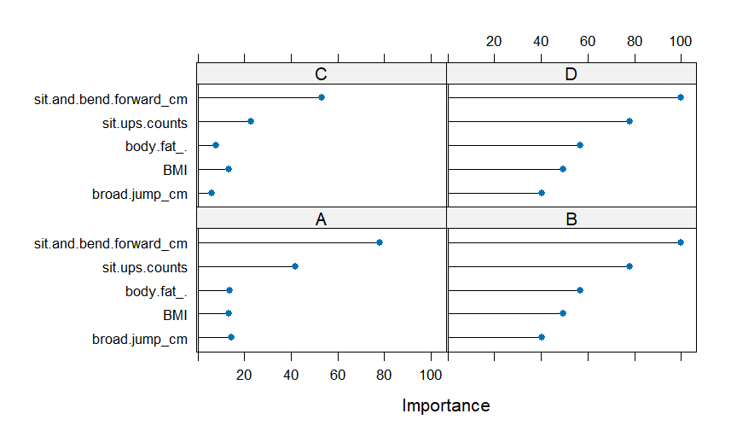
Important Predictors of Support Vector Machine
top5
ROC curve variable importance
variables are sorted by maximum importance across the classes
A B C D
sit.and.bend.forward_cm 77.855 100.000 53.210 100.000
sit.ups.counts 41.721 77.957 22.950 77.957
body.fat_. 13.758 56.848 8.008 56.848
BMI 13.259 49.565 13.220 49.565
broad.jump_cm 14.570 40.371 6.009 40.371
gripForce 3.557 14.279 2.409 14.279
height_cm 14.037 10.197 5.061 14.037
gender 10.274 9.061 6.742 10.274
diastolic 0.000 9.596 0.000 9.596
systolic 1.943 4.993 1.943 4.993
age 3.234 4.069 3.234 4.069

Slide 57
THANK YOU..!!

